Slide 2
Google Patents: Pros and Cons For users of assistive technology, additional details are in the Notes field.
Notes:
The title slide includes the United States Patent Office Seal, the Office of Patent Information Management logo, and The Scientific and Technical Information Center logo.

Slide 3
Objectives
Using Google Patents, participants will be able to:
Understand Google Patents Content,
Understand Pros/Strengths of Google Patents,
Understand Cons/Weaknesses of Google Patents.

Slide 4
Google Patents Content
All documents originate from the USPTO, China, Germany, Canada, the European Patent Office (EPO), the World Intellectual Property Organization (WIPO), and 7 other countries.
The entire collection of granted patents and published patent applications from the USPTO is from 1790. EPO and WIPO coverage is from 1978.
Coverage for Chinese, German and Canadian patent data is unknown.
Google Patents provides links to Google Scholar and Google Books through the Find Prior Art interface. The exact content of Google Scholar and Google Books is unknown.
Notes:
Source of information found at
https://support.google.com/faqs/answer/2539193?hl=en
http://insidesearch.blogspot.com/2013/09/broadening-google-patents.html
Google announced that its patent search service available to patent searchers worldwide has added patent applications from four new patent offices. Now Google patent search engine will provide patent researchers across globe to have access to patents from China Patent Office, Germany (DPMA Patent database), Canada (Canadian Patent Office Database), and the World Intellectual Property Organization (WIPO) which are now aggregated in the Google Patents search database.

Slide 5
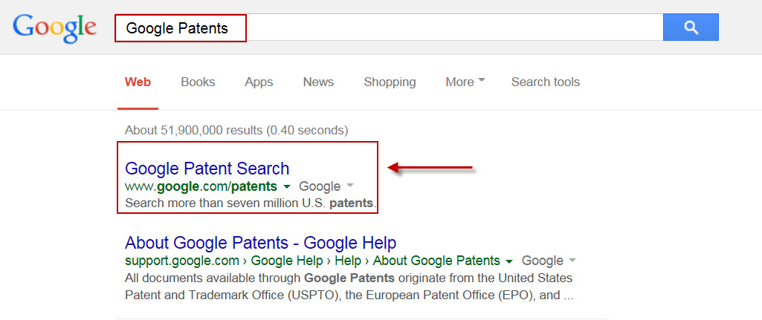
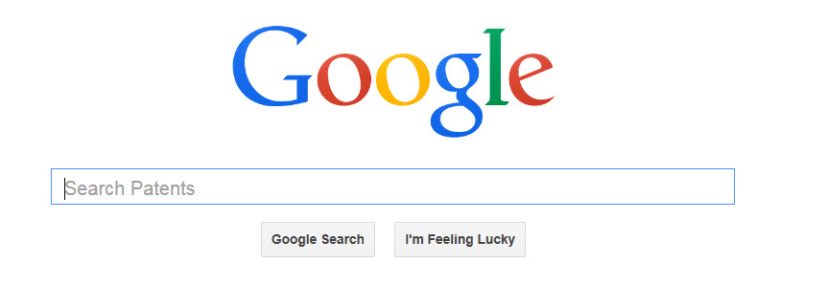
Accessing Google Patents
From the Google home page: Type in Google Patents; select Google Patent Search.

Slide 6
Google Patent Pros/Strengths:
The interface is intuitive.
Relevancy ranking enables quick searches.
EAST/WEST Stopwords may be searched.
Prior Art Finder feature searches patent and non-patent literature sources.

Slide 7
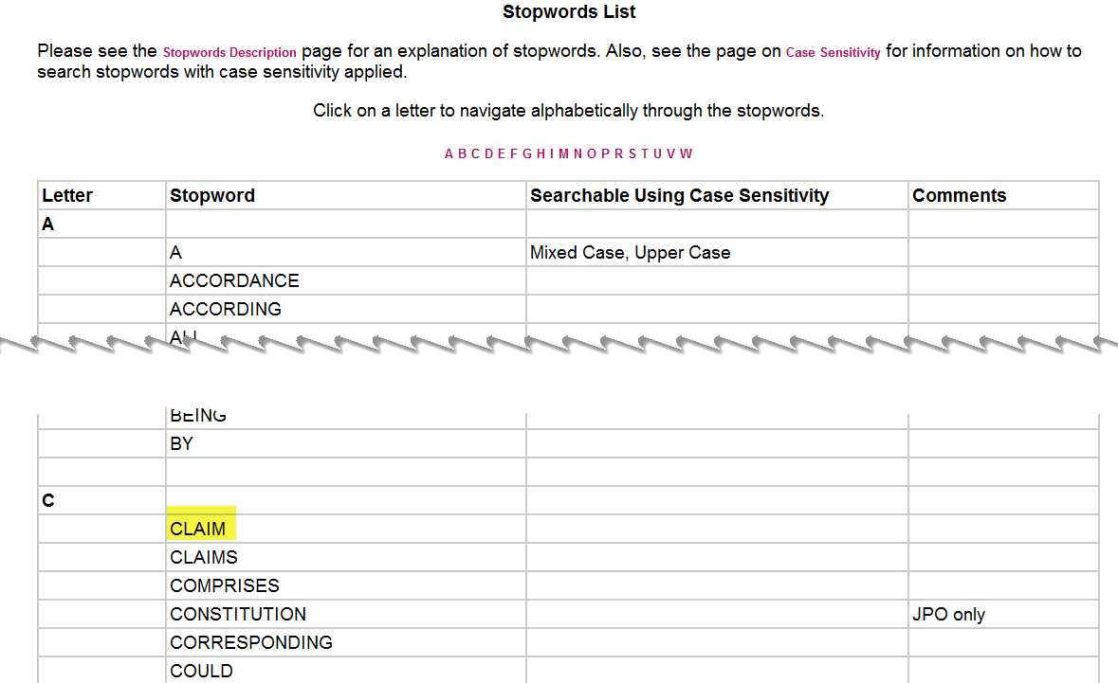
Google Patents Pros/Strengths: Searches EAST/WEST Stopwords
Access the Stopwords list from the EAST Help menu or the Office of Patent Automation (OPA) site.
Notes:
OPIM site with stopwords list. Example showing A and C listing from stopword alphabet.

Slide 8
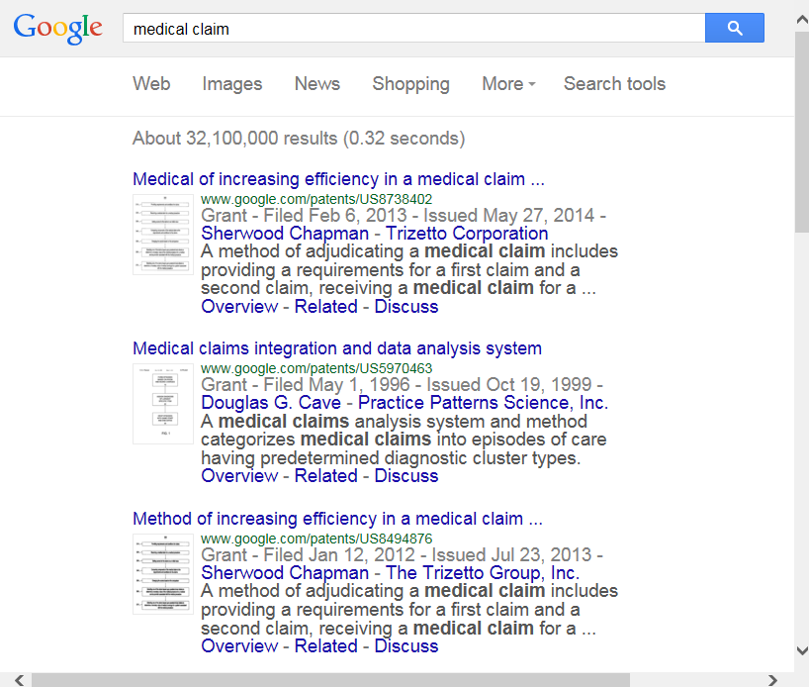
Google Patents Pros/Strengths: Searches EAST/WEST Stopwords
Searching Medical Claim retrieves results.
Notes:
Medical adj claim in EAST or WEST gives zero answers.
Notes: Medical Claim in Google Patents gives 30,900,000 answers (on date May 4th 2015); medical claims in Google Patents gives 29,000,000 and medical (claim OR claims) gives 32,200,000 answers

Slide 9
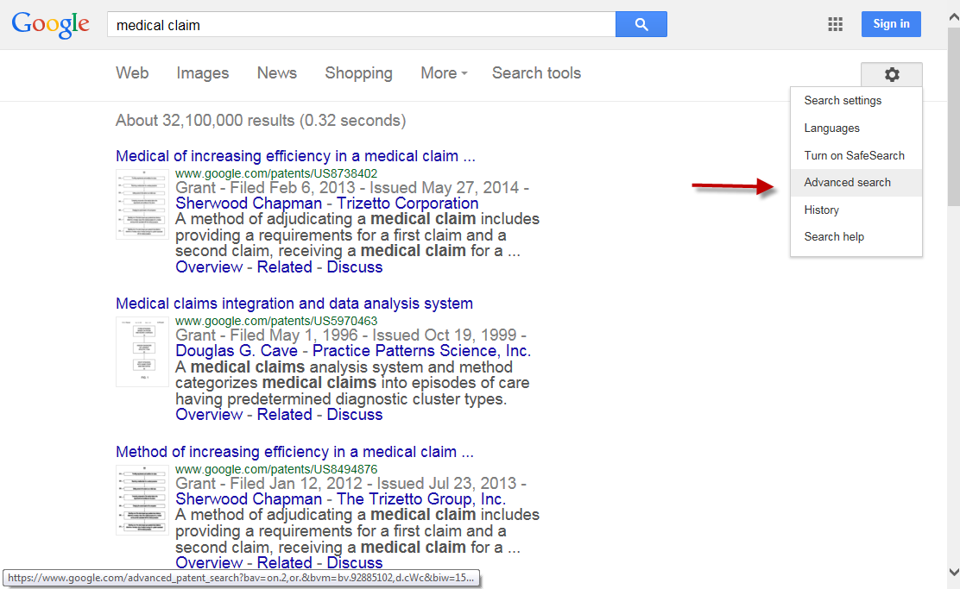
Google Patents Pros/Strengths: Searches CPC Classification
Click Options icon to access Advanced Patent Search.

Slide 10
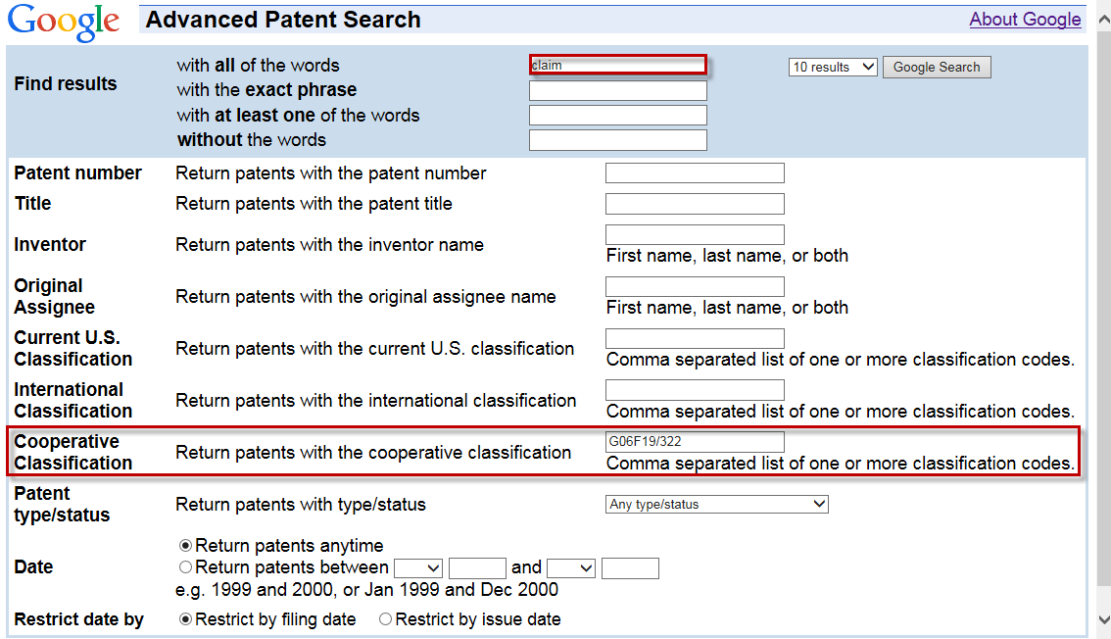
Google Patents Pros/Strengths: Searches CPC Classification 1
Use Advanced Patent Search to limit with Cooperative Patent Classification (CPC) code G06F19/322 (Management of patient personal data…).

Slide 11
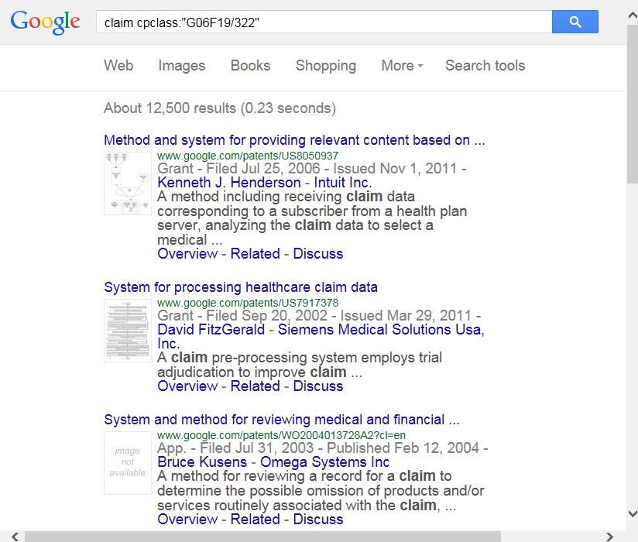
Google Patents Pros/Strengths: Searches CPC Classification 2
Notes:
results

Slide 12
Google Patents Pros/Strengths: Find Prior Art Button

Slide 13
Google Patents Pros/Strengths: Prior Art Finder Features
Identifies key phrases from EPO, WIPO and post-1976 US patents and combines them into a search query.
Searches not only Google Patents, but simultaneously searches Google Scholar, Google books and the rest of the Web.
Results can be tuned by date and are ranked by relevancy using algorithms that combine multiple signals to determine order of search results.
Notes:
Information found https://support.google.com/faqs/answer/2539193?hl=en

Slide 14
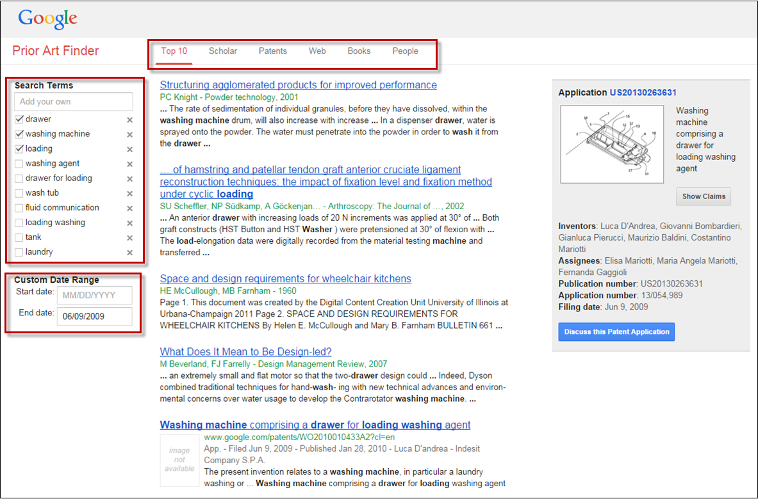
Google Patents Pros/Strengths: Prior Art Finder Search Results
Notes:
Can remove or add extra search terms.

Slide 15
Google Patents Pros/Strengths: Prior Art Finder Search Results 1

Slide 16
Google Patents Pros/Strengths: Prior Art Finder Search Results
Notes:
The People tab allows you to search Google Scholar articles, patents and books by inventors. Inventors of the target patent publication are listed first followed by inventors of cited in the target patent publication.

Slide 17
Google Patents Pros/Strengths: EAST-like Proximity Operators
You can use proximity operators to boost the score of documents if they contain expressions near each other. Note: proximity operators only change ranking, not retrieval. NEAR, NEARx, NEAR/x, or /xw means matches are a maximum of x words away, in any order. WITH means 20 words away, any order, and SAME means 200 words away, any order. AJD, AJDx, ADJ/x, or +xw are the same as NEAR, but matches must be in the same order.
Example: (safety ADJ/5 belt) NEAR/10 (baby OR child) SAME vehicle.

Slide 18
Google Patents Pros/Strengths: Restrict Search to Specific Sections
You can search inside a specific field using field names.
Use TI=(safety belt) to search in the title, AB= for the abstract and CL= for the claims.
For CPCs, CPC=B60R22 will match documents with exactly this CPC, CPC=B60R22/low matches documents with this CPC or a child classification of this CPC. CPCs can also be searched without a field prefix.

Slide 19
Google Patents Pros/Strengths: Variety of Wildcards/Truncation
Although Google automatically generates plurals, you can instead specify wildcard patterns of words to search. Wildcards only work on single words. The top 25 most common matches will be ORed together. Note: wildcards only work on English words.
The wildcards are ? (zero or one character), * or $ (zero or more characters), $x (zero to x characters), and # (exactly one character). You can include more than one wildcard symbol per word. Examples: *saccharide? and hydroxy*phenyl*.

Slide 20
Google Patents Cons/Weaknesses:
Inappropriate synonyms may be added automatically.
Not all cited references are included.
There are uploading delays.
A Google Patents search can find prior art, but it is not a complete search.

Slide 21
Google Patent Cons/Weaknesses: Search Algorithm
How the search algorithm works is unknown.
“The technology behind Google’s search results, PageRank and other weighting algorithms, is maintained within Google as a trade secret. Nobody has been able to fully figure them out.”
Relevance algorithms are not static but change over time.
Notes:
“The technology behind Google’s search results, PageRank and other weighting algorithms, is maintained within Google as a trade secret. Nobody has been able to fully figure them out.” Quote redacted from Intellectual Property and Open Source: A practical guide to protecting Code. By Van Lindberg. 2008 Page 130

Slide 22
Google Patents Cons/Weaknesses: Disclosure Risk
Google tracks search activity (see Privacy policy).
MPEP 904.02(c)
When the Internet is used to search, browse, or retrieve information relating to a patent application which has not been published, other than a reissue application or reexamination proceeding, Patent Organization users MUST restrict search queries to the general state of the art unless the Office has established a secure link over the Internet with a specific vendor to maintain the confidentiality of the unpublished patent application. Non-secure Internet search, browse, or retrieval activities that could disclose proprietary information directed to a specific application which has not been published, other than a reissue application or reexamination proceeding, are NOT permitted.
Notes:
Examiners must use a general state of the art search and not their specific case.
Google tracks search activity (see Privacy policy https://www.google.com/intl/en/policies/privacy/?fg=1).

Slide 23
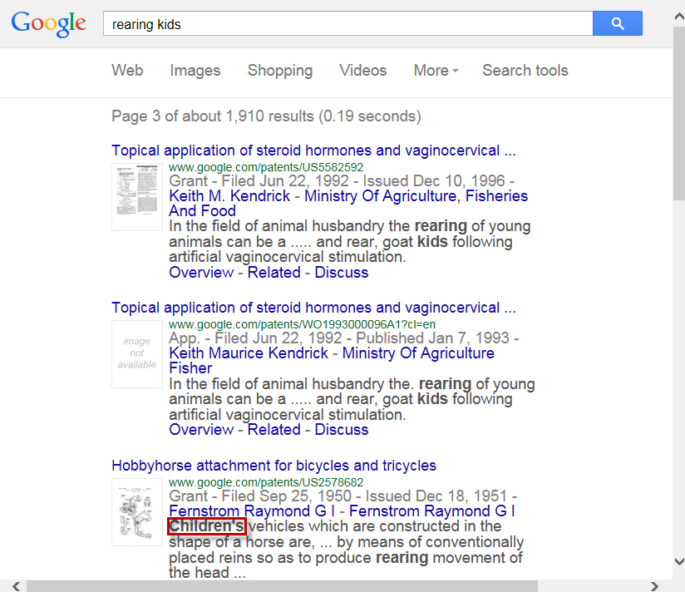
Google Patent Cons/Weaknesses: Inappropriate Synonyms
Synonyms are based on popular media sources and not necessarily taken from the scientific community.
A basic search on Rearing Kids (livestock) will automatically retrieve the synonym “children” giving hits that may not be relevant.

Slide 24
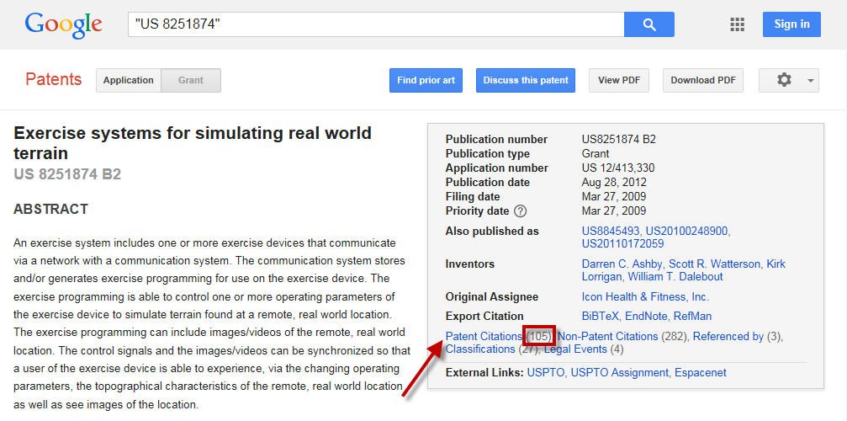
Google Patent Cons/Weaknesses: Missing Citations
Google patent search indicated 105 citations of US Patent Documents
are associated with US 8,251,874.
Notes:
Cited US Patent Documents found in US 8,251,874

Slide 25
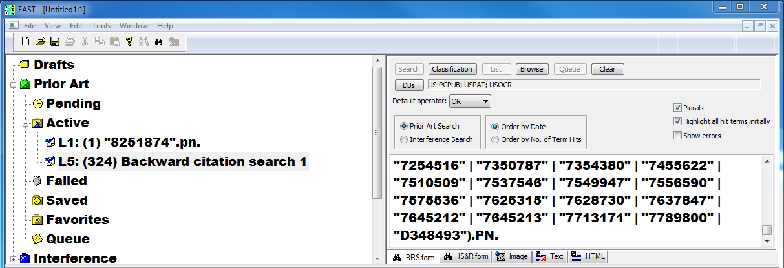
Google Patent Cons/Weaknesses: Missing Citations 1
While EAST search indicates 324 US references cited for US 8,251,874.
Notes:
Google lost over 200 granted patents and published applications during transferal of the data from this US patent to its database. These missing cites are in the Google patents repository and the error appears to be a scanning error.

Slide 26
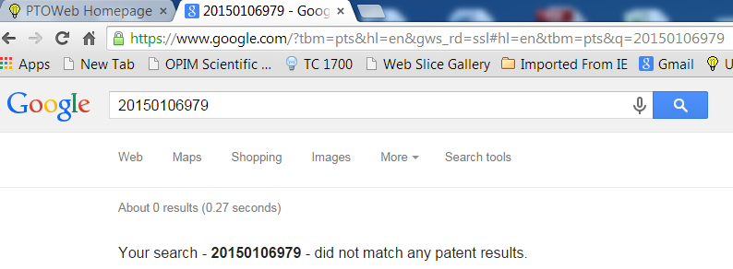
Google Patent Cons/Weaknesses: Uploading Delay
Google patent search retrieved zero results.

Slide 27
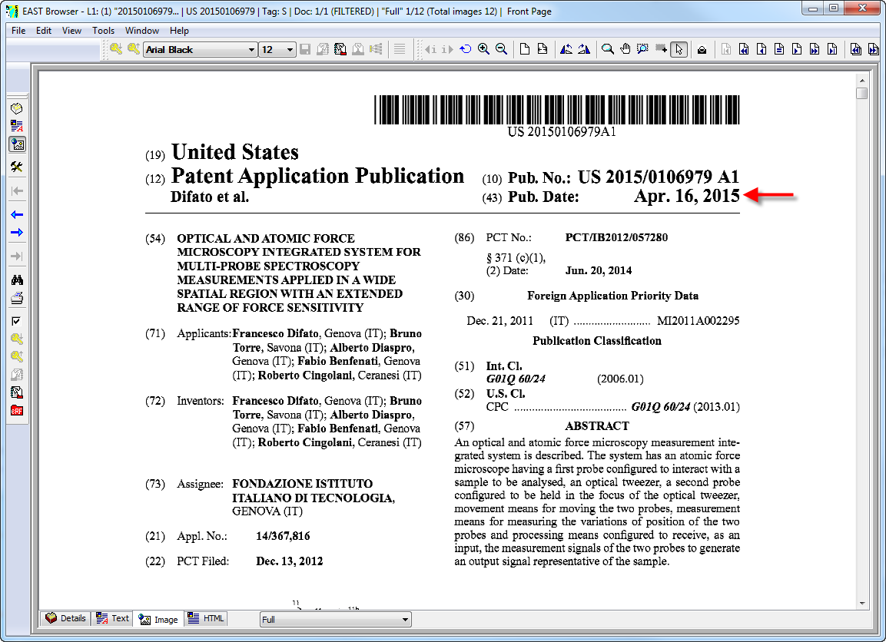
Google Patent Cons/Weaknesses: Uploading Delay 1
EAST search retrieved Pre-Grant Publication 20150106979.
Note publication date.
Notes:
US 20150106979 was published April 16th 2015.

Slide 28
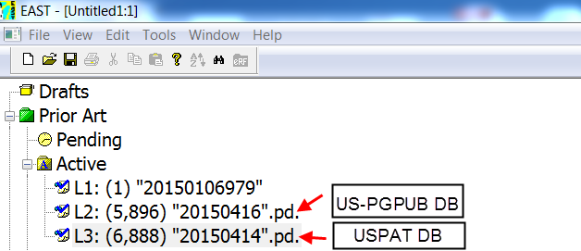
Google Patent Cons/Weaknesses: Uploading Delay
Notes:
US 20150106979 was published April 16th 2015. Lag of about 6 weeks before published US grants and applications appear in Google Patents. This was tested extensively both for US grants and published applications.
Note: April 16th 2015 is a Thursday when the US Pre-Grant Publications database is updated. April 14th 2015 is a Tuesday when the US Patents database is updated.

Slide 29
Google and EAST/WEST Feature Chart
Feature | Google | EAST/WEST
Relevancy ranking | X
Order by Hit Term Number |  | X
Searches Stopwords | X
Prior Art Finder | X
Transparent |  | X
Confidential |  | X
Adds synonyms | X
Complete Citation data |  | X
Current US Patent data |  | X
Save and rerun searches |  | X
Notes:
This chart compares Google and EAST/WEST for Relevancy ranking, Order by Hit Count, Stopword Search, Prior Art Finder, Transparent, Confidential, Added Synonyms, Missing Cited References, and Current US Patent data.

Slide 30
Objectives Covered
Using Google Patents, participants are able to:
Understand Google Patents Content,
Understand Pros/Strengths of Google Patents,
Understand Cons/Weaknesses of Google Patents.

Slide 31
THANK YOU
Notes:
This closing slide includes the United States Patent and Trademark Office Seal, the Office of Patent Information Management logo, and the Scientific and Technical Information Center logo.

