Slide 2
How to Pop
Google's Filter Bubble
Don’t Let Google Customize your Search

Slide 3
Objectives
Participants will be able to:
Define Filter Bubble and personalized search.
Limit Filter Bubble by using Google syntax and varying search tools.

Slide 4
What is the Filter Bubble?
Research bias occurs when search engines customize results based on past user behavior and preferences.
Two people searching on the same term receive a different sequence of results.
From the book, “Filter Bubble: What the Internet is Hiding From You”, by Eli Pariser (2011).
Notes:
Filter Bubble definition – PC Magazine
The introduction to Pariser’s book highlights Google's December 2009 announcement that it would start using some 57 signals to determine the results it reports to users.
http://www.pcmag.com/encyclopedia/term/64417/filter-bubble
Copyright © 1981- 2016 , The Computer Language Company Inc.
Filter Bubble definition - Techopedia
https://www.techopedia.com/definition/28556/filter-bubble

Slide 5
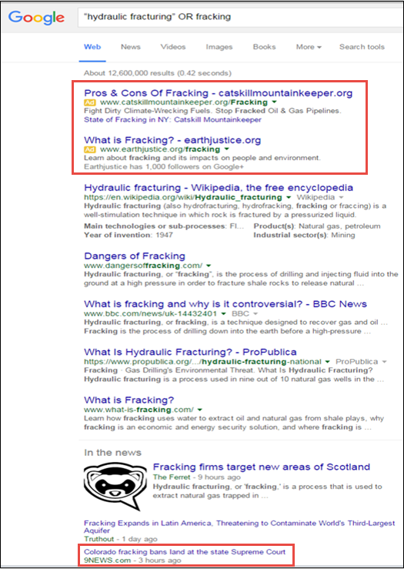
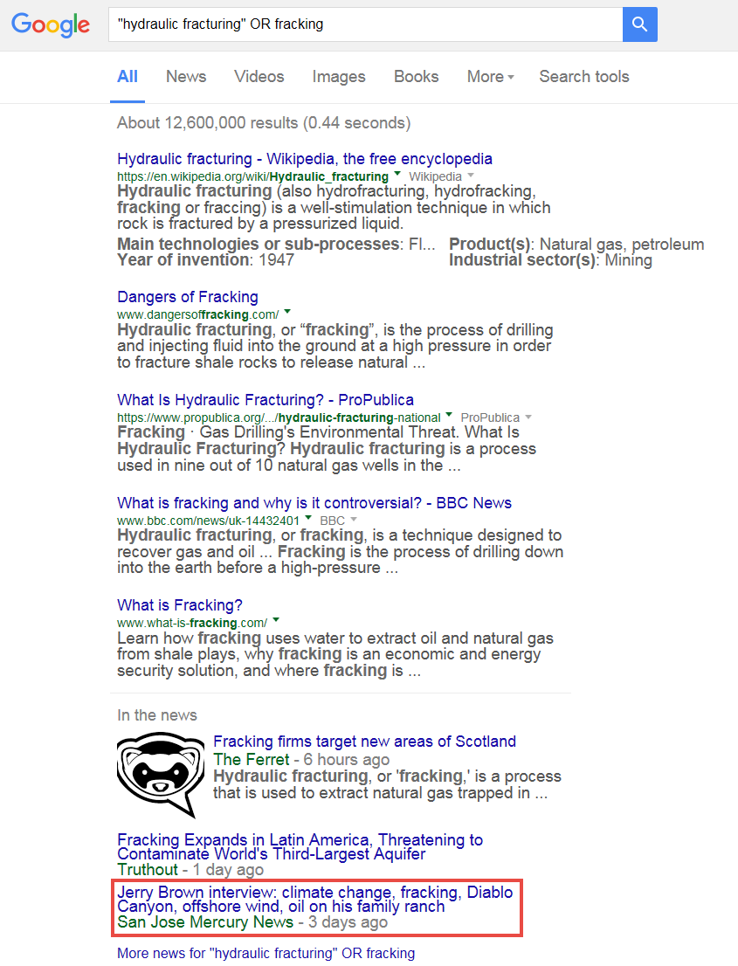
Same Google Search Query
Different Searchers – Different Results
Notes:
Instructor note: Two people using the same search query retrieve a different sequence of results.
Hydraulic Fracturing definition: Extracting oil or natural gas by injecting a mixture of water, sand or gravel, and certain chemicals under high pressure into well holes in dense rock to create fractures that the sand or gravel holds open, allowing the oil or gas to escape. Also called fracking.
Hydraulic Fracturing. (2011). In The Editors of the American Heritage Dictionaries & TheEditorsoftheAmericanHeritageDictionaries (Eds.), The American Heritage Dictionary of the English language. Boston, MA: Houghton Mifflin. Retrieved from http://search.credoreference.com/content/entry/hmdictenglang/hydraulic_fracturing/0

Slide 6
What is Personalized Search?
The term, filter bubble, is associated with personalized search, a Google feature which tailors results for each user.
When a search is run in Google, an algorithm compares available search results with results clicked on in the past, enabled by cookies planted on the browser.
Notes:
Note: Although this demo focuses on Google personalized search Bing also uses personalized search and Facebook provides personalized news streams.
https://www.techopedia.com/definition/28556/filter-bubble

Slide 7
User Behavior Assessed by Google
Google weighs “User Behavior” in its algorithm
- browsing history
- clicked ads
- Gmail emails
- Google+ friends choices
- Viewed content in other Google properties, e.g. YouTube.
Once a User is signed out of Google, the algorithm may use location and device information.
- Country, Language and City
- Device plus Operating System and Browser
Notes:
Search Engine Land’s Guide to SEO: Personalization and Search Engine Rankings http://searchengineland.com/guide/seo/personalization-search-engine-rankings
Heather Physioc, Tentacle Inbound: The Complex Web of Personalized Search http://www.tentacleinbound.com/articles/personalized-search

Slide 8
Filter Bubble and Research
While Personalized Search can help with shopping and localized search purposes, it can lead to results which are incomplete or skewed.
For rigorous research, it is important to get out of the filter bubble as much as possible.

Slide 9
User Behavior Assessed by Google
Google weighs “User Behavior” in its algorithm
- browsing history
- clicked ads
- Gmail emails
- Google+ friends choices
- Viewed content in other Google properties, e.g. YouTube.
Once a User is signed out of Google, the algorithm may use location and device information.
- Country, Language and City
- Device plus Operating System and Browser
Notes:
Search Engine Land’s Guide to SEO: Personalization and Search Engine Rankings http://searchengineland.com/guide/seo/personalization-search-engine-rankings
Heather Physioc, Tentacle Inbound: The Complex Web of Personalized Search http://www.tentacleinbound.com/articles/personalized-search

Slide 10
Popping the Filter Bubble
Be a proactive searcher.
Use Google syntax to better control search results.
Search Google Scholar, which is not ad driven.
Try a non-Google search engine.

Slide 11
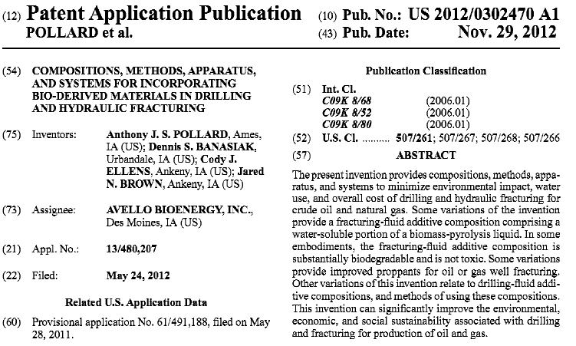
Example PreGrant Publication
Notes:
This is example is a Pre-Grant publication of an patent application for Compositions, Methods, Apparatus and Systems for Incorporating Bio-derived Materials in Drilling and Hydraulic Fracturing.
Definitions
Hydraulic Fracturing: Extracting oil or natural gas by injecting a mixture of water, sand or gravel, and certain chemicals under high pressure into well holes in dense rock to create fractures that the sand or gravel holds open, allowing the oil or gas to escape. Also called fracking.
Hydraulic Fracturing. (2011). In The Editors of the American Heritage Dictionaries & The Editors of the American Heritage Dictionaries (Eds.), The American Heritage Dictionary of the English language. Boston, MA: Houghton Mifflin. Retrieved from http://search.credoreference.com/content/entry/hmdictenglang/hydraulic_fracturing/0

Slide 12
Google Syntax
Google’s site: command limits a search query to a specific website.
“Hydraulic fracturing” OR fracking site:NIST.gov
When typing the above command there is no space between site: and NIST.gov
The National Institute of Standards (NIST), advances measurement science, standards, and technology.
Notes:
http://www.nist.gov/public_affairs/general_information.cfm

Slide 13
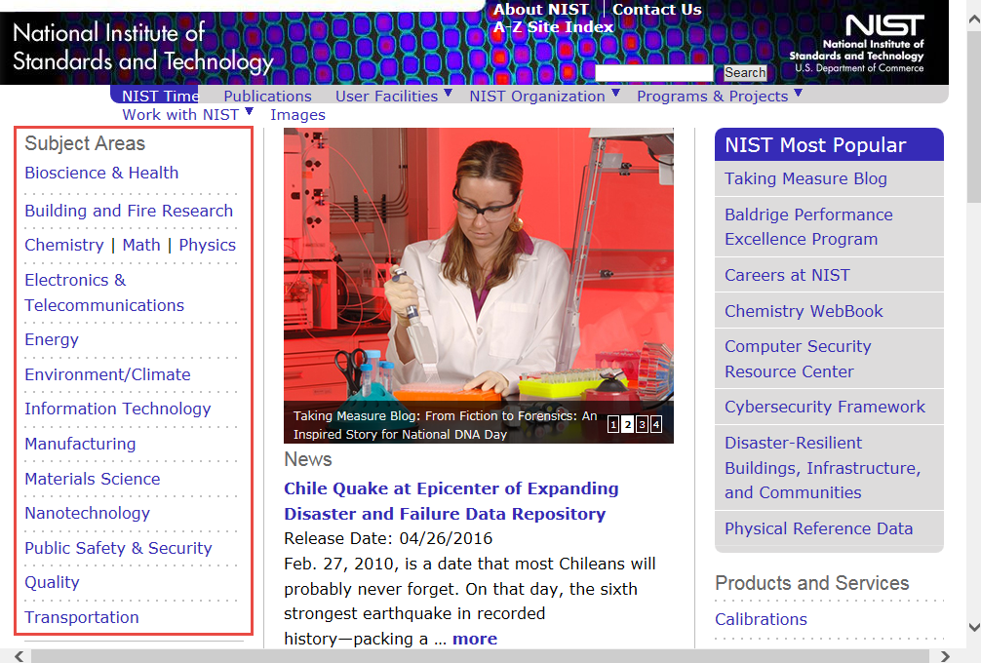
NIST website
(http://nist.gov)
Notes:
The NIST web page encompasses a wide variety of engineering fields including bioscience, building and fire research, chemistry, telecommunications, information technology, transportation and materials science. The diversity of information contained ensures it to be a relevant source of information for many patent examiners.

Slide 14
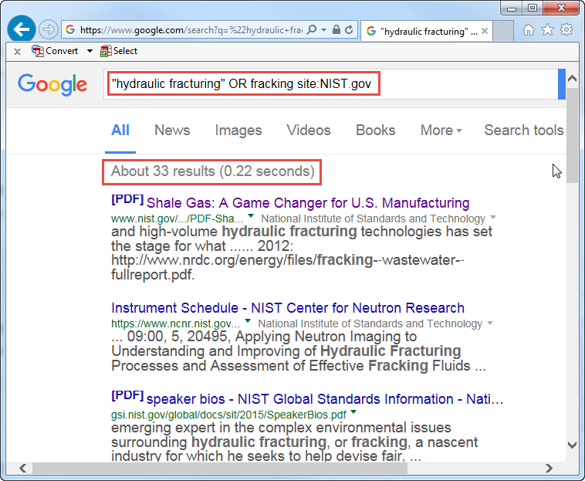
NIST Site Search

Slide 15
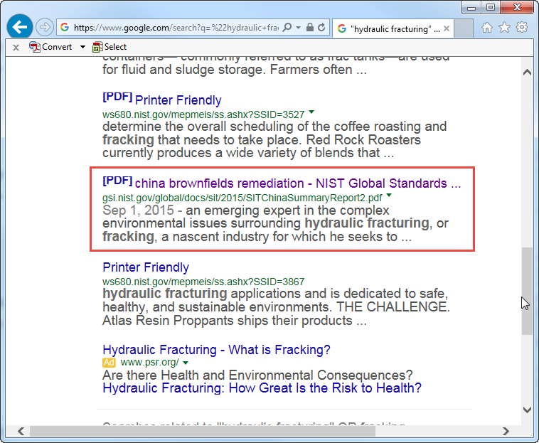
Search Result of Interest

Slide 16
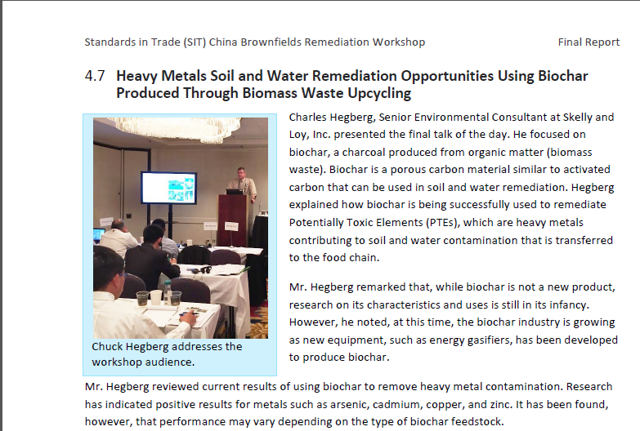
Standards in Trade (SIT) China Brownfields Remediation Workshop
Notes:
Standards in Trade (SIT) is a NIST workshop program that provides opportunities for cooperation on topics related to standards, conformity assessment and trade. SIT workshops are designed to introduce U.S. stakeholders to emerging standards and conformity assessment issues in other countries and regions; identify technical barriers to trade; and provide timely information to foreign officials on U.S. practices in standards, metrology, and conformity assessment. http://gsi.nist.gov/global/Docs/SIT_workshops.pdf
Biochar: A solid material obtained from thermochemical conversion of biomass in an oxygen-limited environment. Biochar can be used for a range of applications as an agent for soil improvement, improved resource use efficiency, remediation and/or protection against particular environmental pollution and as an avenue for greenhouse gas (GHG) mitigation. In addition, to be recognized as biochar, the material has to pass a number of material property definitions that relate both to its value (e.g., H/Corg ratios relate to the degree of charring and therefore mineralization in soil) and its safety (e.g., heavy metal content).
Adapted from: Lehmann, J., and Joseph, S. (2015). Biochar for Environmental Management: An Introduction. In: Biochar for Environmental Management - Science and Technology, 2nd edition. J. Lehmann and S. Joseph (eds.). Routledge. http://www.biochar-international.org/definitions

Slide 17
Google Scholar
Searches scholarly literature across disciplines.
Ranks documents using full text, publisher, author and citation data.
Does not include ads and does not need to tailor results.
Provides full text access to articles from journals to which STIC subscribes.
Notes:
https://scholar.google.com/intl/en/scholar/about.html

Slide 18
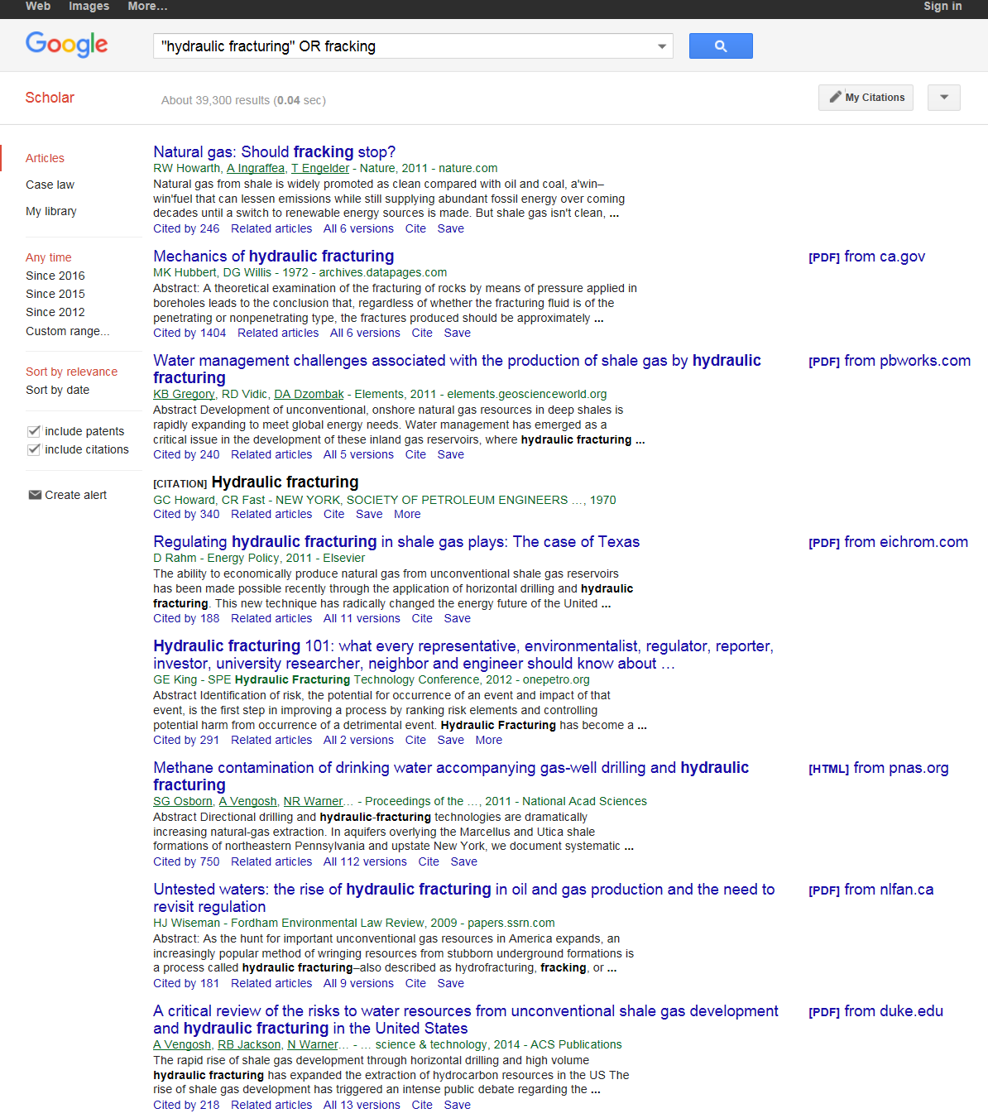
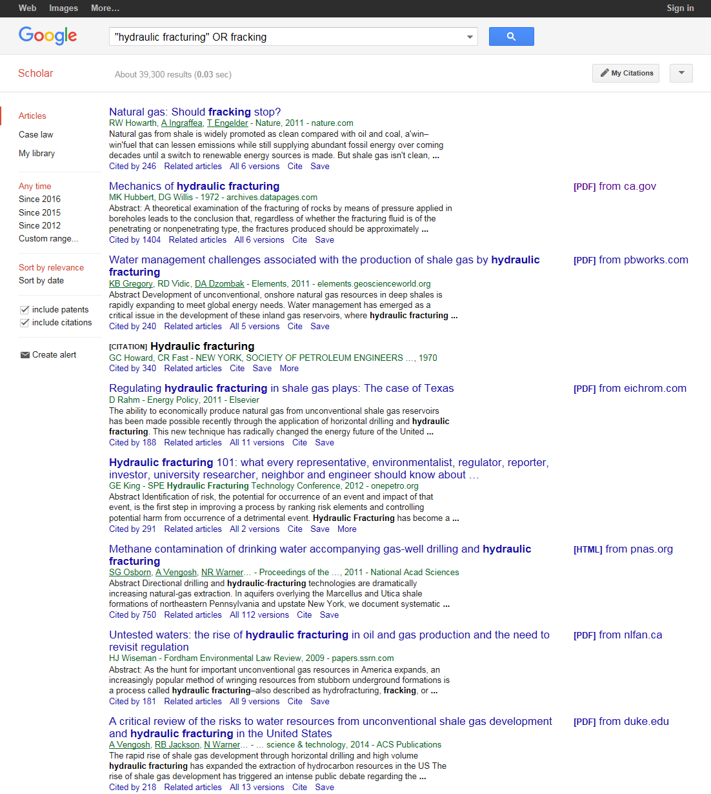
Google Scholar Search Query
Different Searchers – Identical Results

Slide 19
ScienceResearch.com
(non-Google)
Deep Web Technologies product.
Federated search engine, searches a number of databases simultaneously.
Searches over 300 authoritative science and technology collections.
Uses relevancy ranking based on length of file, search term location and frequency.
Groups results into topics.
Searches collections in real time.
Removes duplicate results.
Notes:
ScienceResearch.com information links
http://scienceresearch.com/scienceresearch/images/about.pdf
http://scienceresearch.com/scienceresearch/faq.html

Slide 20
ScienceResearch.com
Search Query
Put quotes around exact phrase
Use Boolean operator OR
“hydraulic fracturing” OR fracking
Notes:
These tips will work with any of the DeepWeb Technology websites.
Scienceresearch.com, Biznar, Mednar, Worldwidescience, etc.
Science.gov, Science Accelerator, Scitopia, etc.

Slide 21
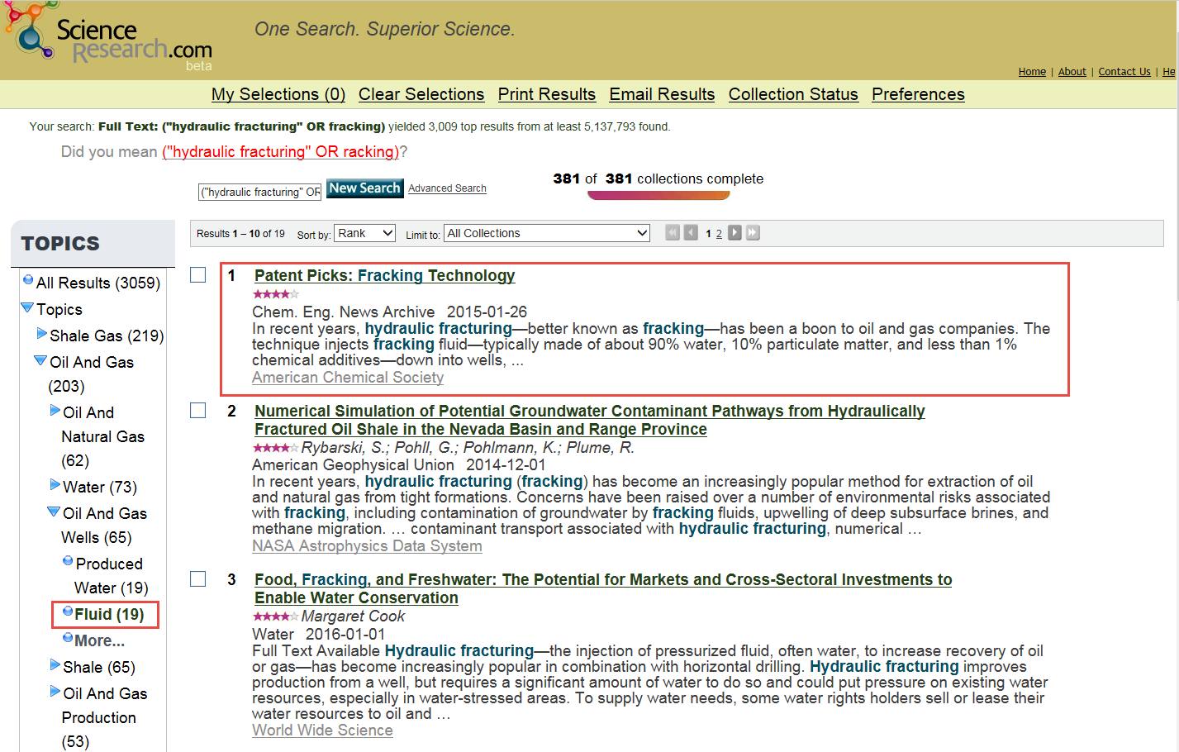
ScienceResearch.com
Select topic, such as Fluid, to narrow search.
Notes:
ScienceResearch.com is a Deep Web Technologies search engine that retrieves results over 300 authoritative science and technology collections, and searches the Deep Web. Each search is done in real-time and duplicate results are removed.
http://scienceresearch.com/scienceresearch/images/about.pdf

Slide 22
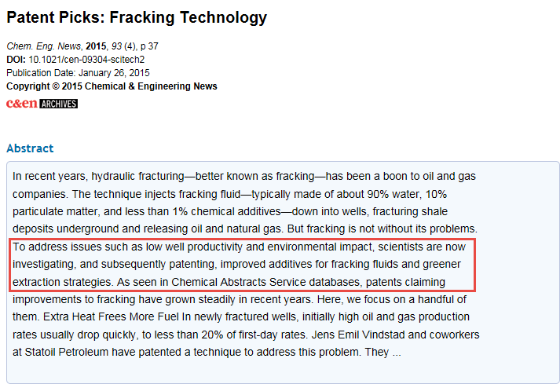
Chem. Eng. News Abstract

Slide 23
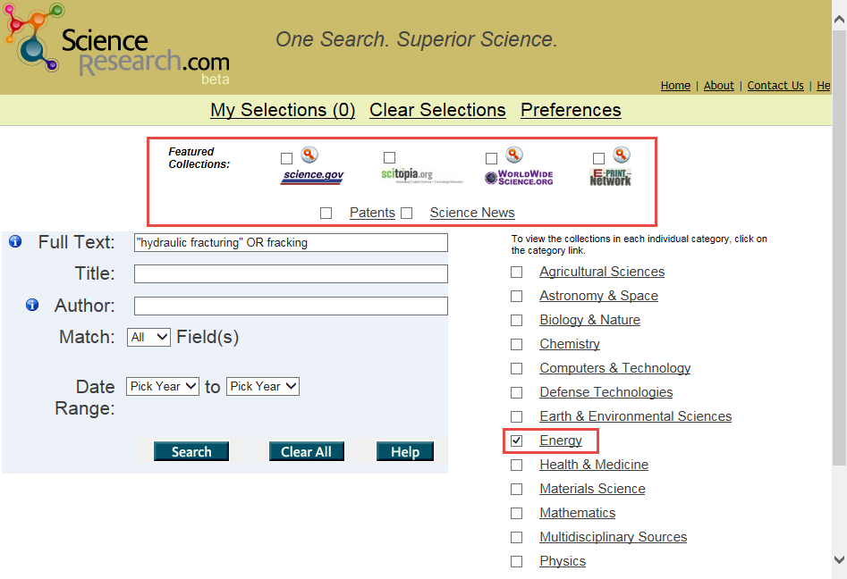
Advanced Search
Notes:
ScienceResearch.com Advanced Search shows available field searches and selectable Featured Collections, such as Science.gov, WorldWideScience.org, Patents and Science News. Scitopia and E-Print Network have been discontinued. Collections may also be selected by Category, such as energy.

Slide 24
Objectives
Participants are able to:
Define filter bubble and personalized search.
Limit filter bubble by using Google syntax and varying search tools.

Slide 25

THANK YOU
Notes:
This closing slide includes the United States Patent and Trademark Office Seal, the Office of Patent Information Management logo, and the Scientific and Technical Information Center logo.

